Slide 1

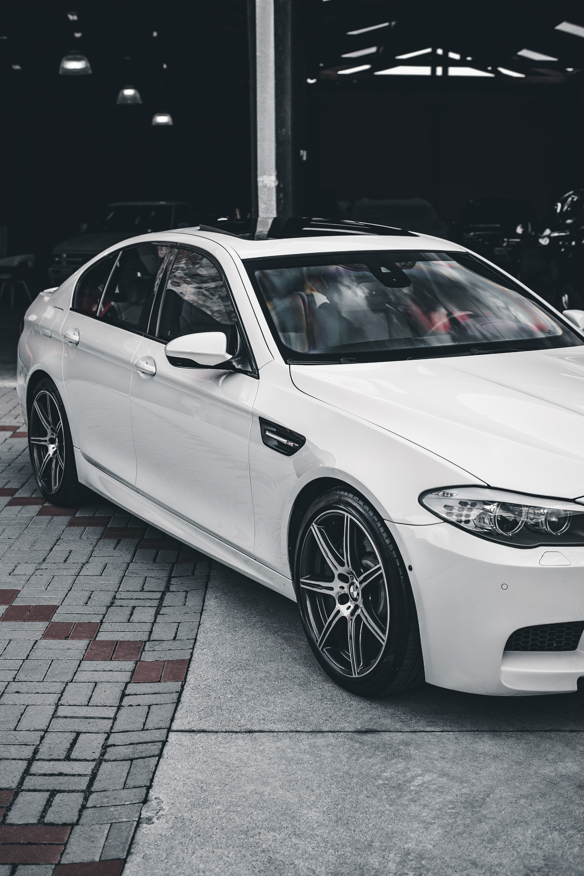

WEBX CA
AUTOMARKET
PRESENTATION
Prathamesh Palve | D15A-31

Slide 2
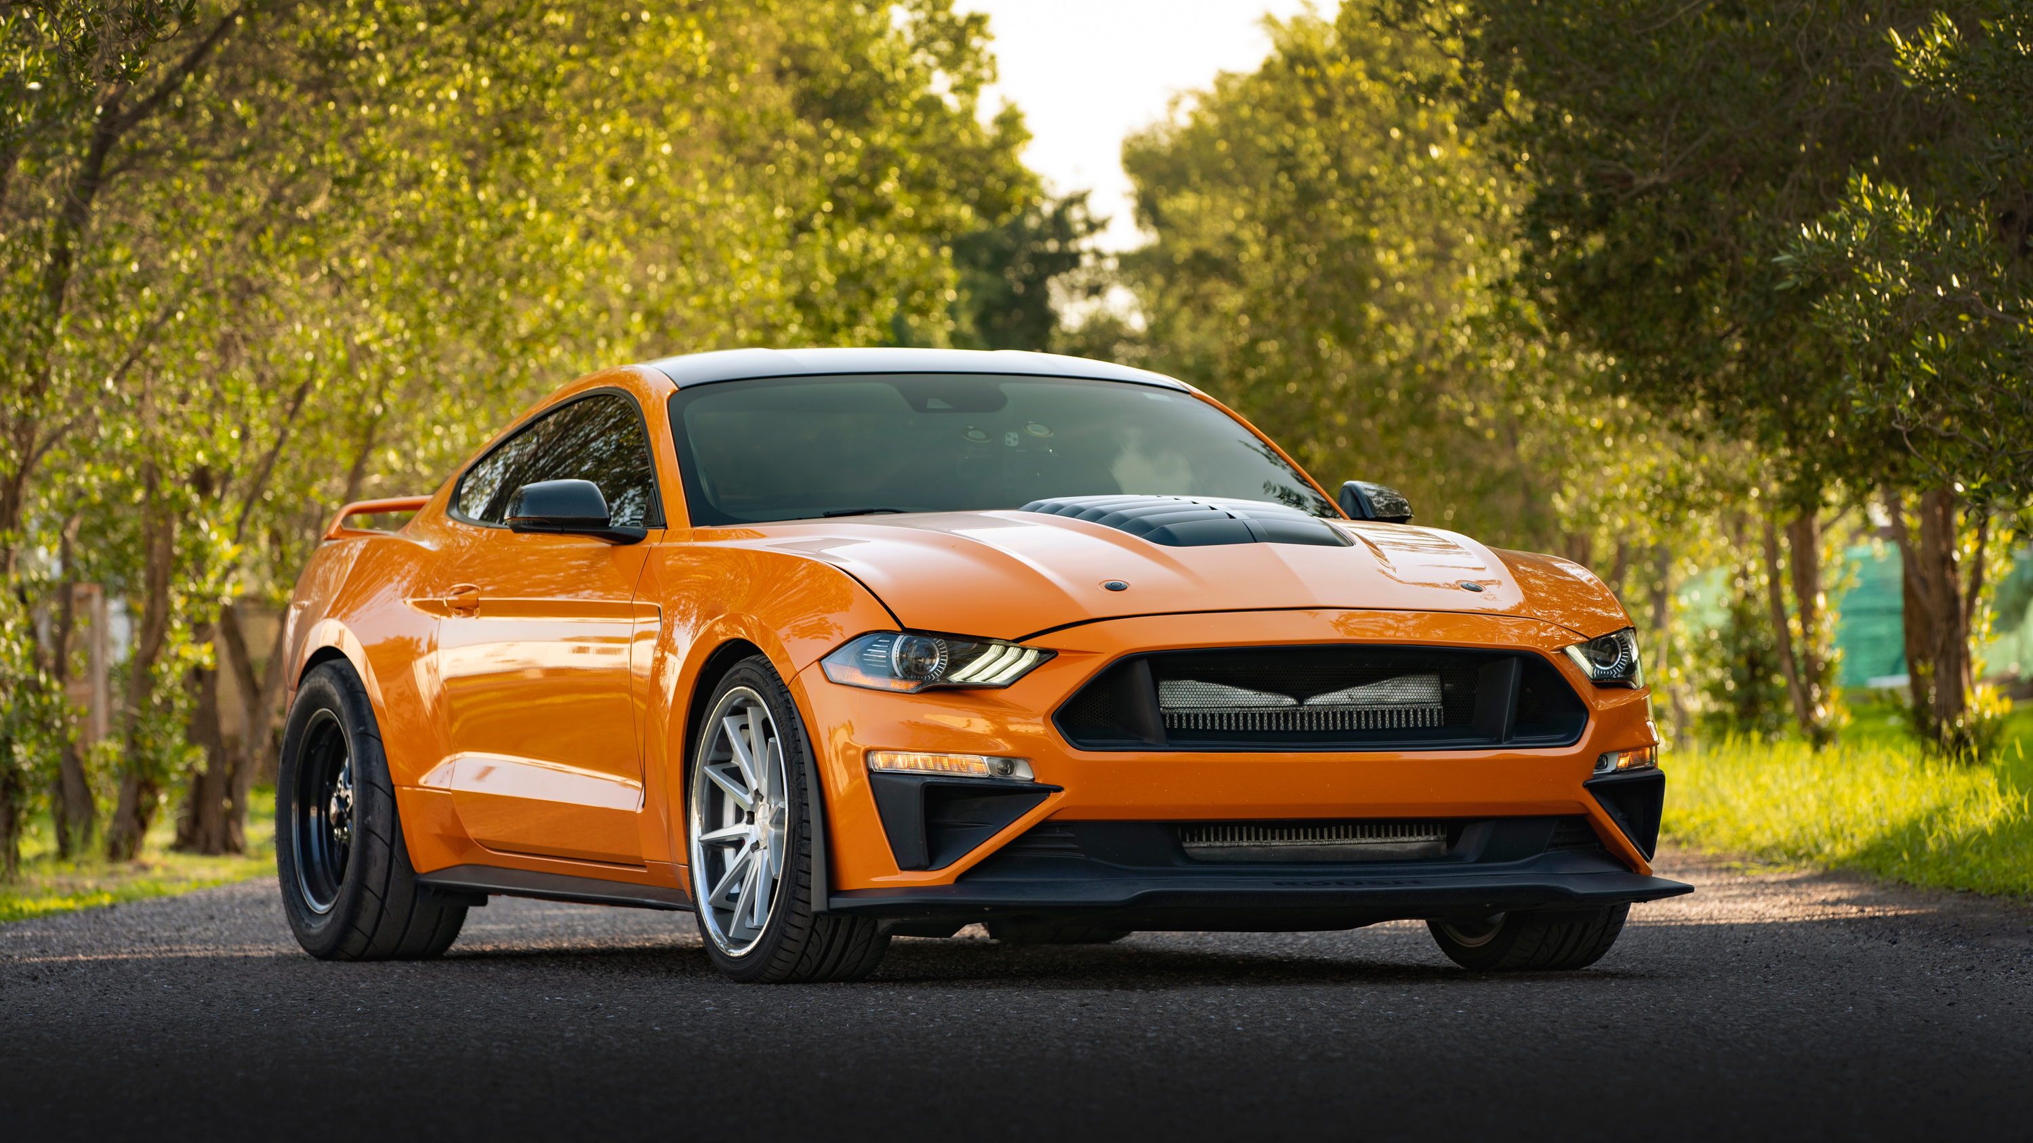

INTRODUCTION
AutoMarket is a full-stack web application developed using React for the frontend, Flask for the backend, and MongoDB as the database.
It is a car buying/selling platform where users can browse featured vehicles, chat with sellers in real-time, predict car prices using AI, and compare different models for informed decisions.

Slide 3
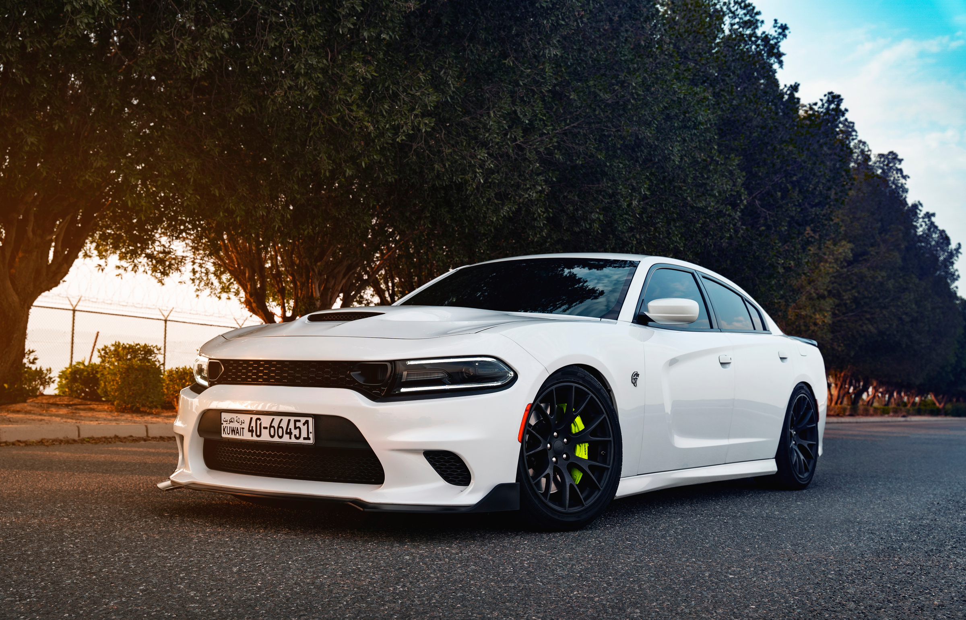
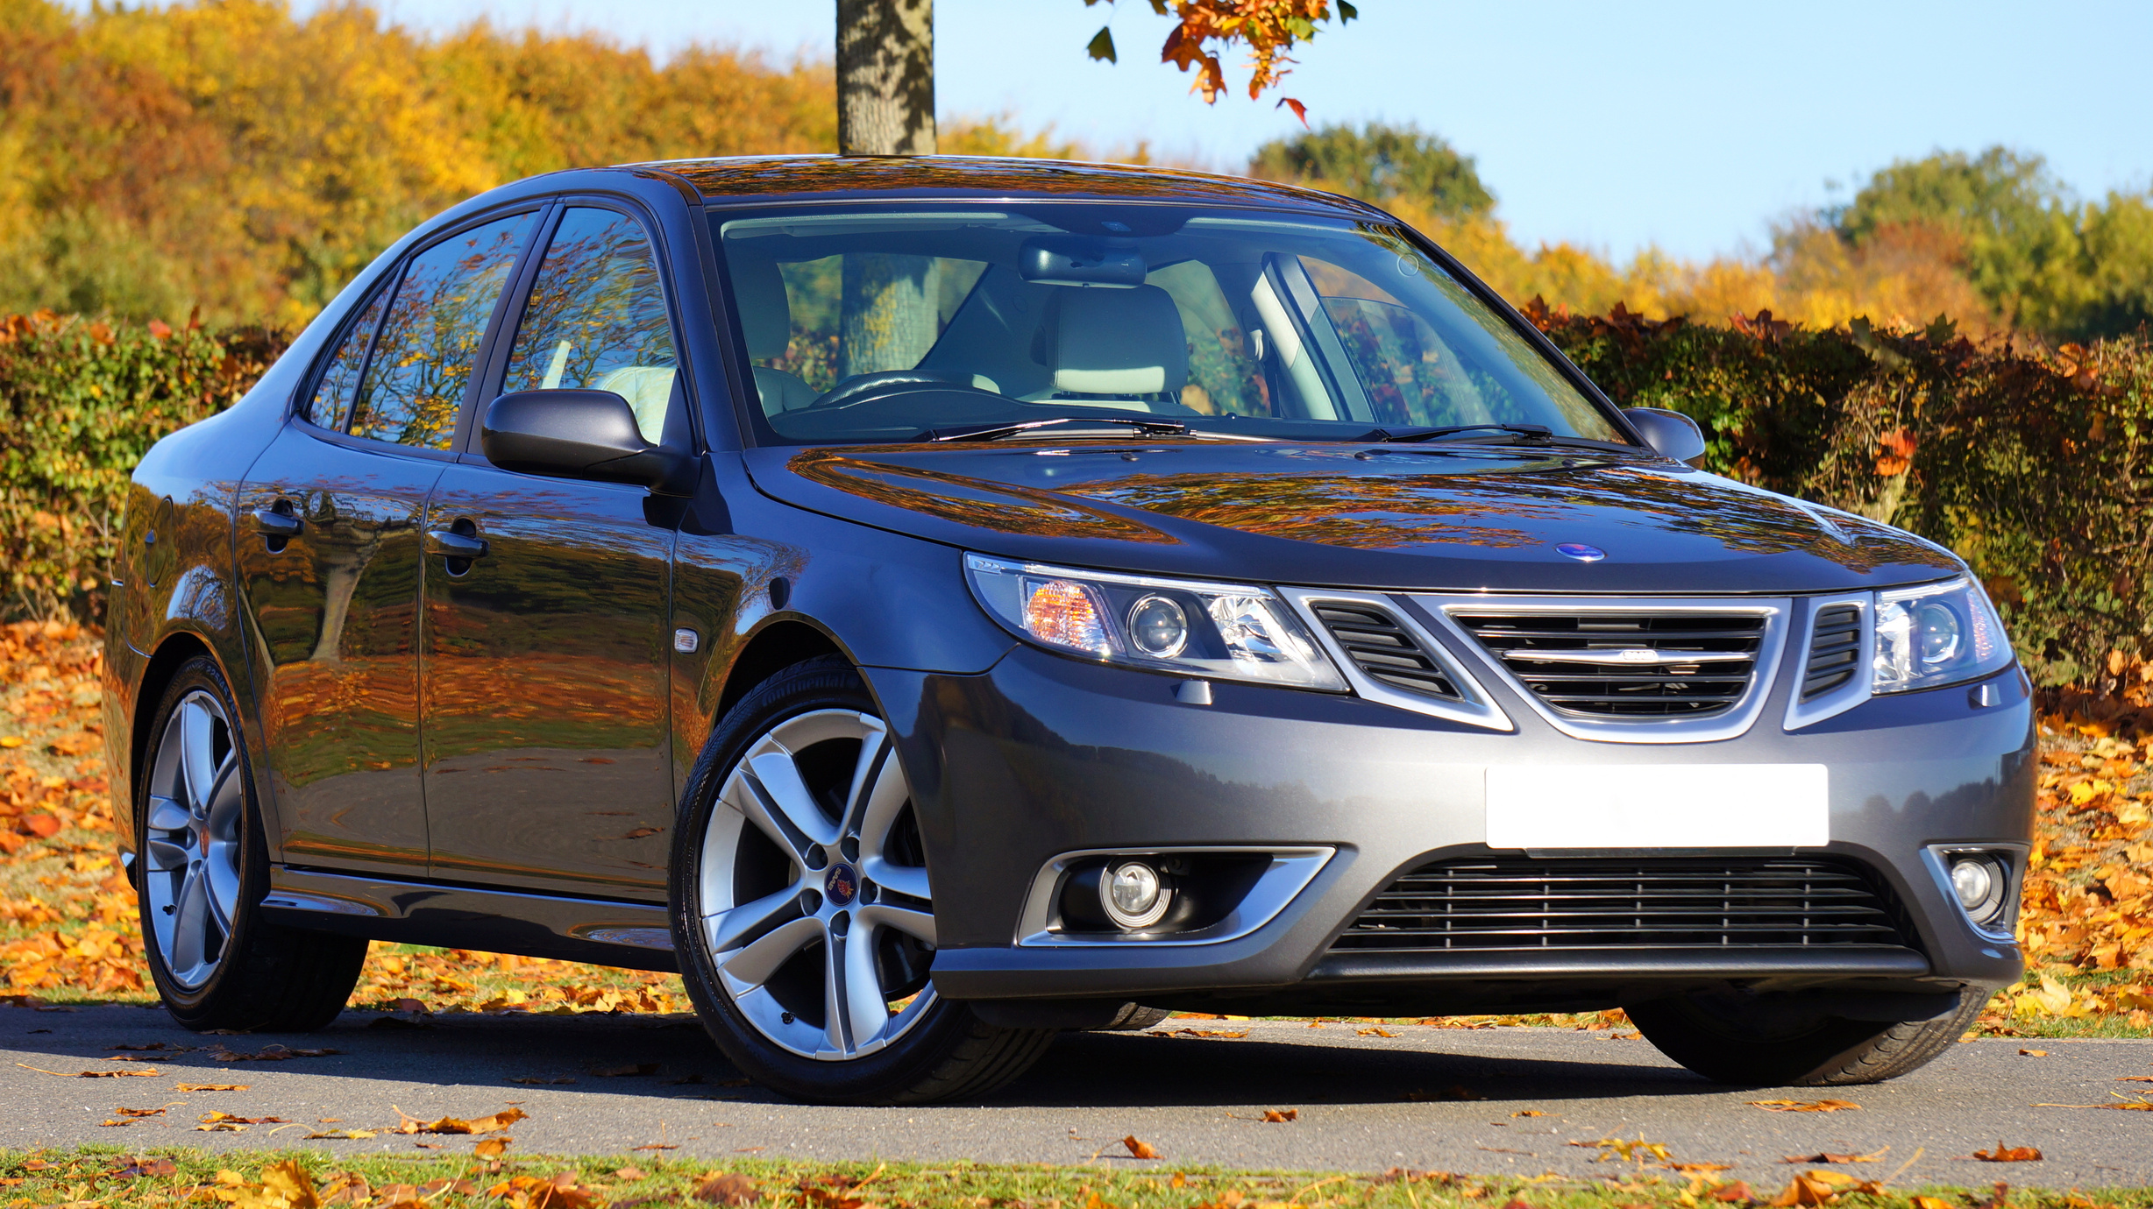
PROBLEM STATEMENTS & PROBLEMS
Lack of Transparency
Inefficient Communication
Manual Price Estimation
No Comparison Tools

Slide 4
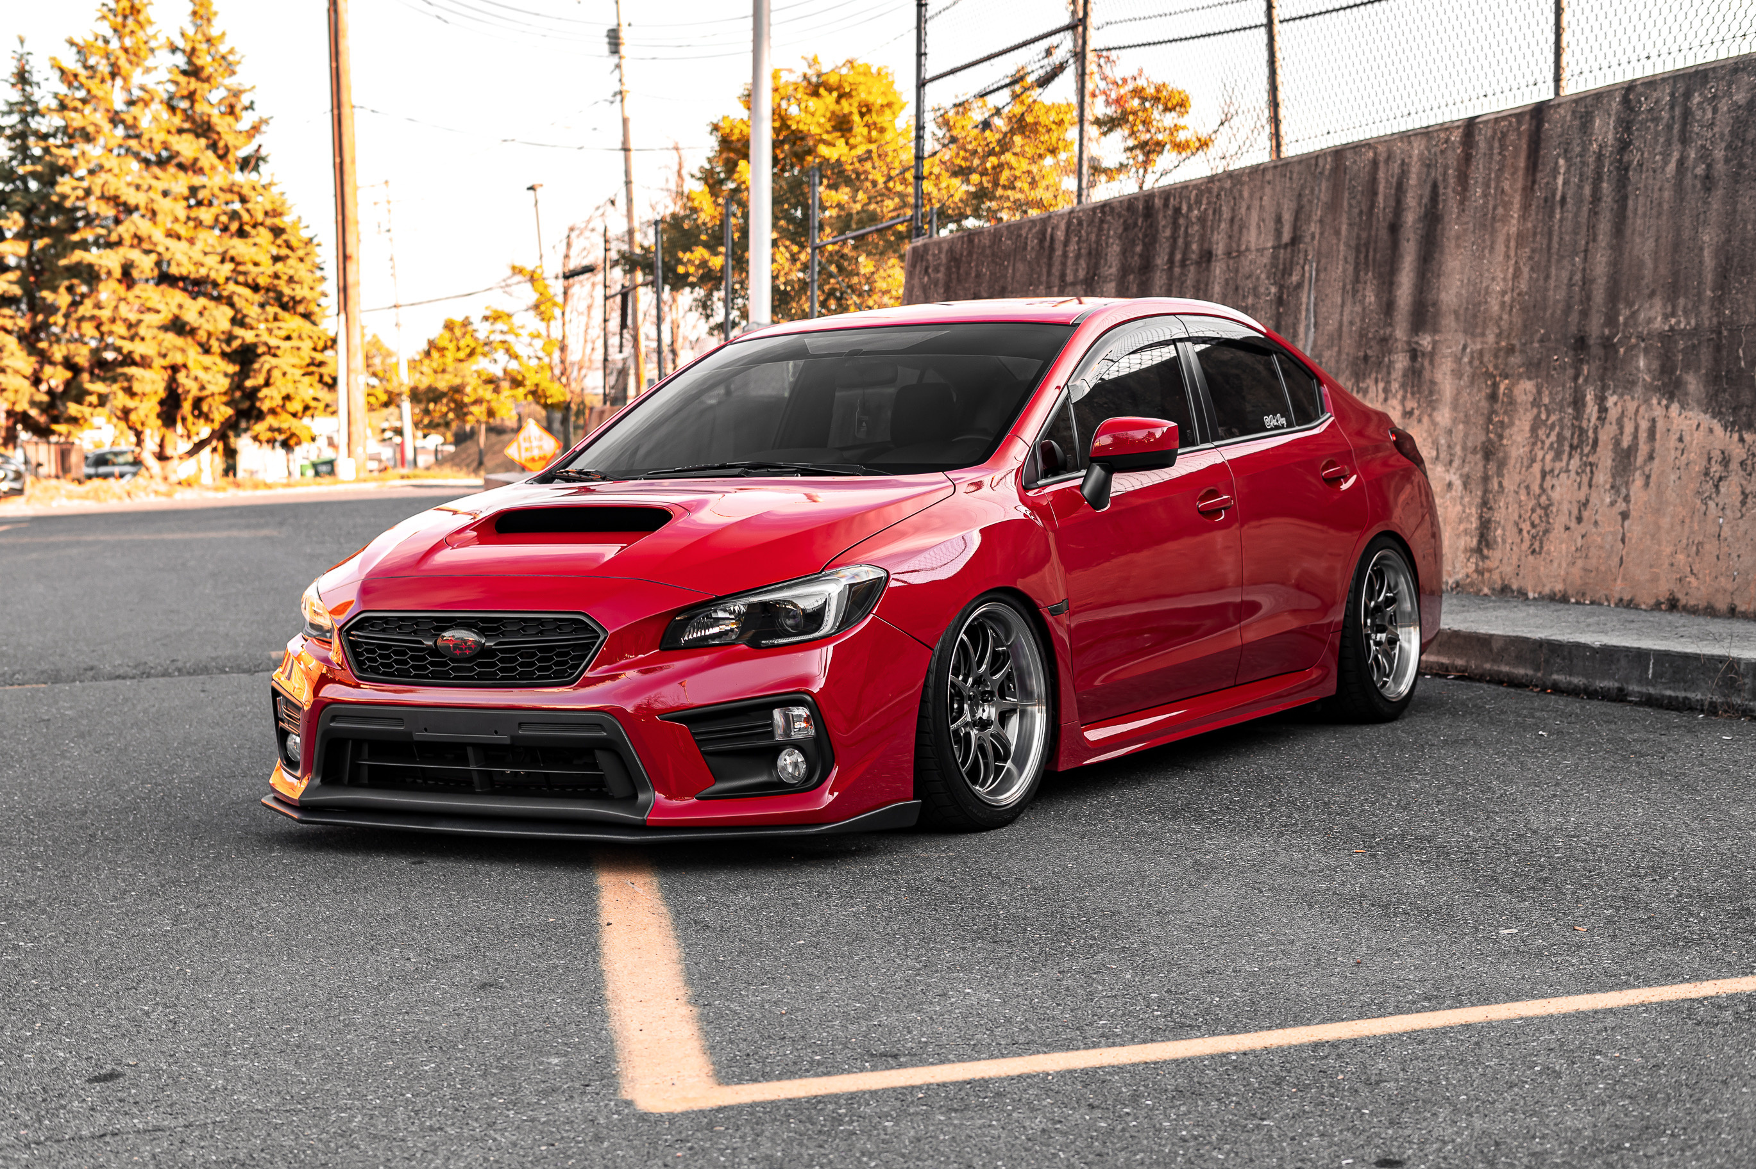
OUR VISION & MISSION
Vision
Mission
"To revolutionize the car trading industry by creating a transparent, AI-driven marketplace that connects buyers and sellers seamlessly."
Provide a trusted platform with verified vehicle listings.
Empower users with real-time communication and AI-powered tools.
Simplify car trading through comparison features and fair pricing insights.

Slide 5
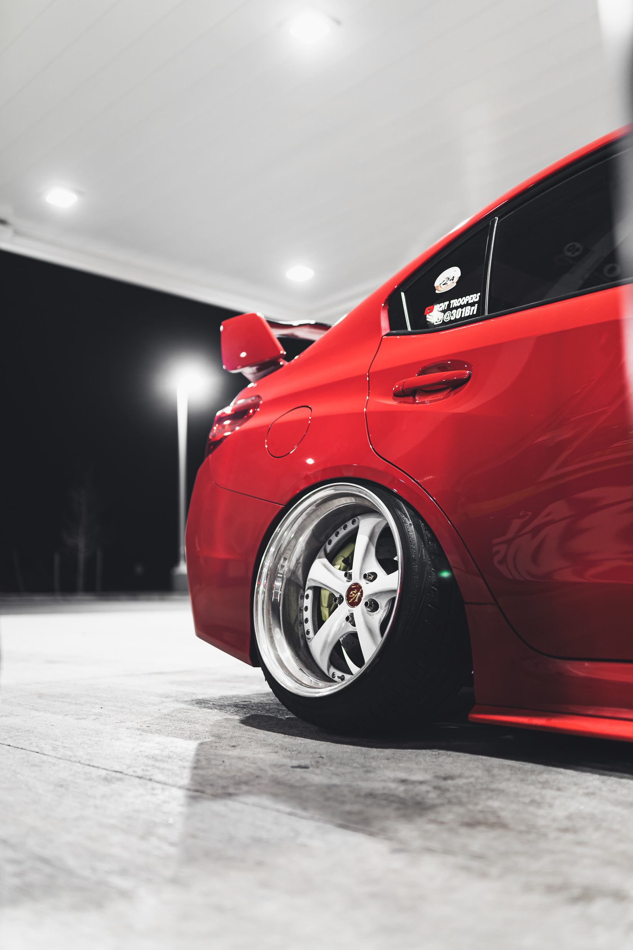


TECHSTACK
Frontend - React - Typescript
Backend - Python Flask
Databse - MongoDB

Slide 6
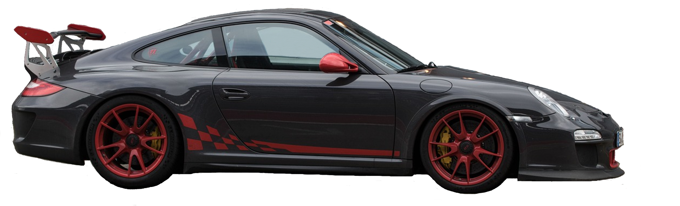



FEATURES
REAL TIME CHAT
VEHICLES PRICE
PREDICTION
COMPARING
VEHICLES
Instant communication between buyers and sellers.
Machine learning model for fair pricing.
Based on 500,000+ historical sales data points.
Side-by-side analysis of different models.
Compare up to 5 vehicles simultaneously

Slide 7

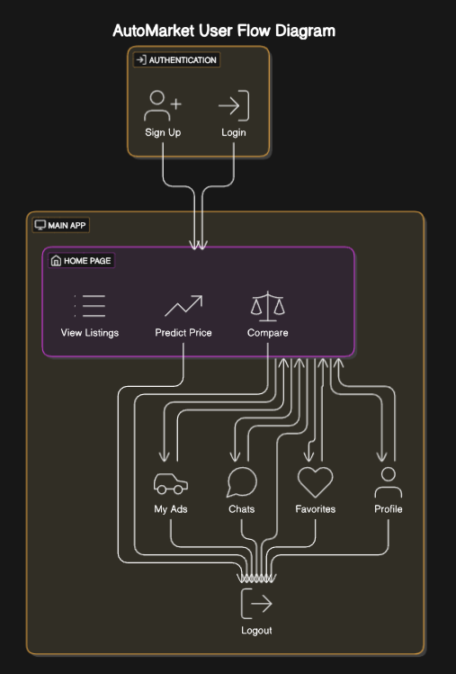
ARCHITECTURE DIAGRAM

Slide 8
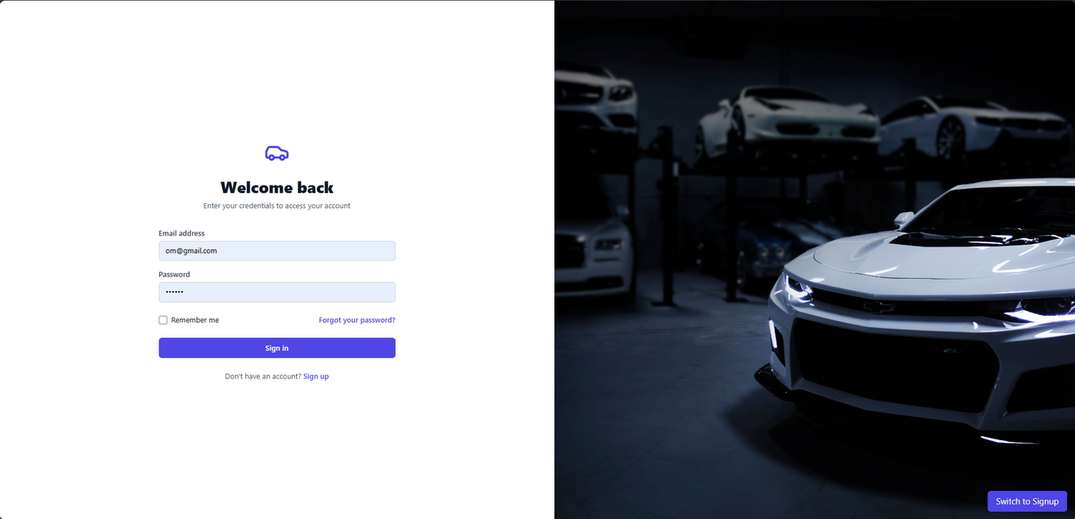
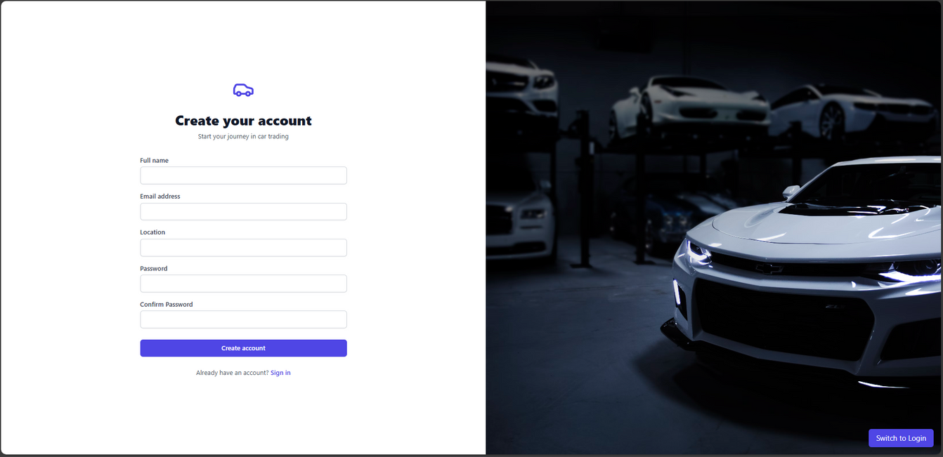
SCREENSHOTS
LOGIN PAGE
SIGNUP PAGE

Slide 9
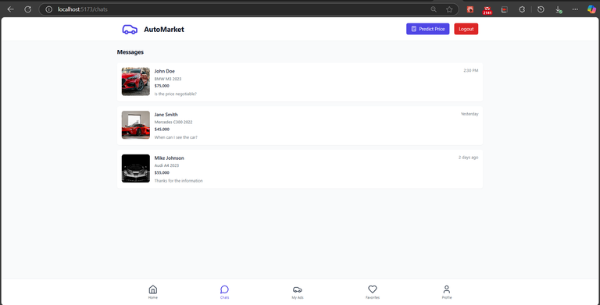
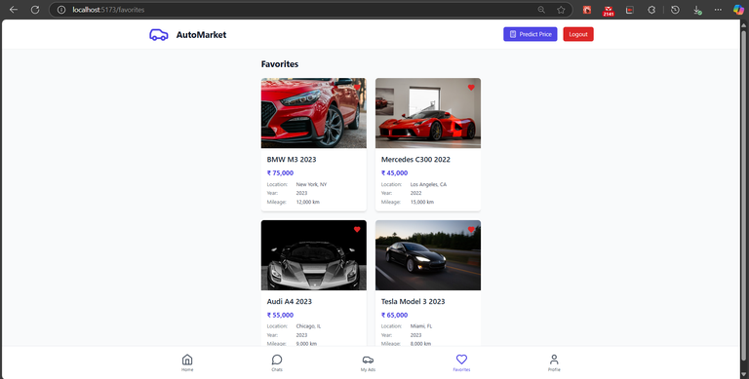
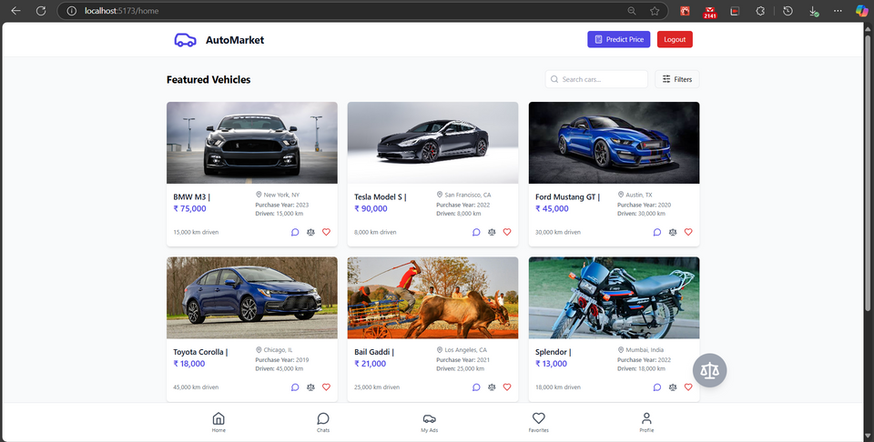
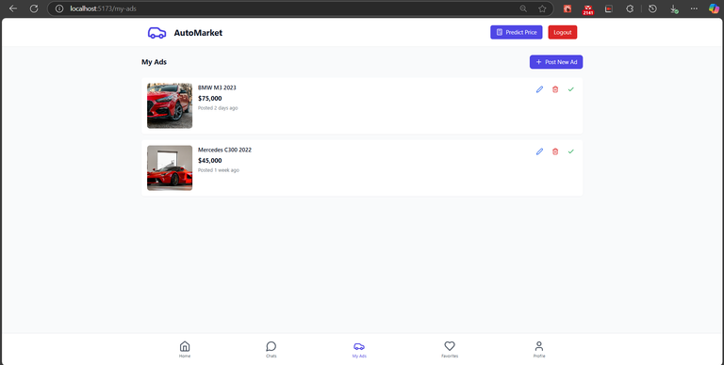
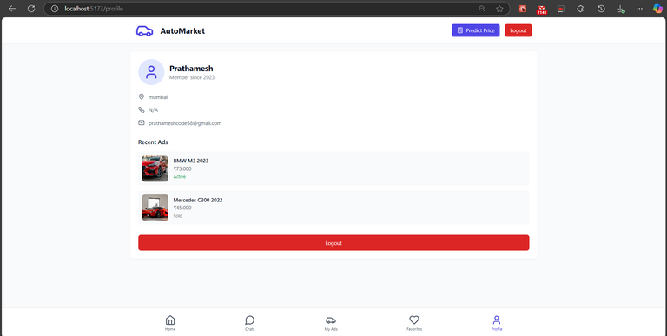
SCREENSHOTS
HOME PAGE

Slide 10
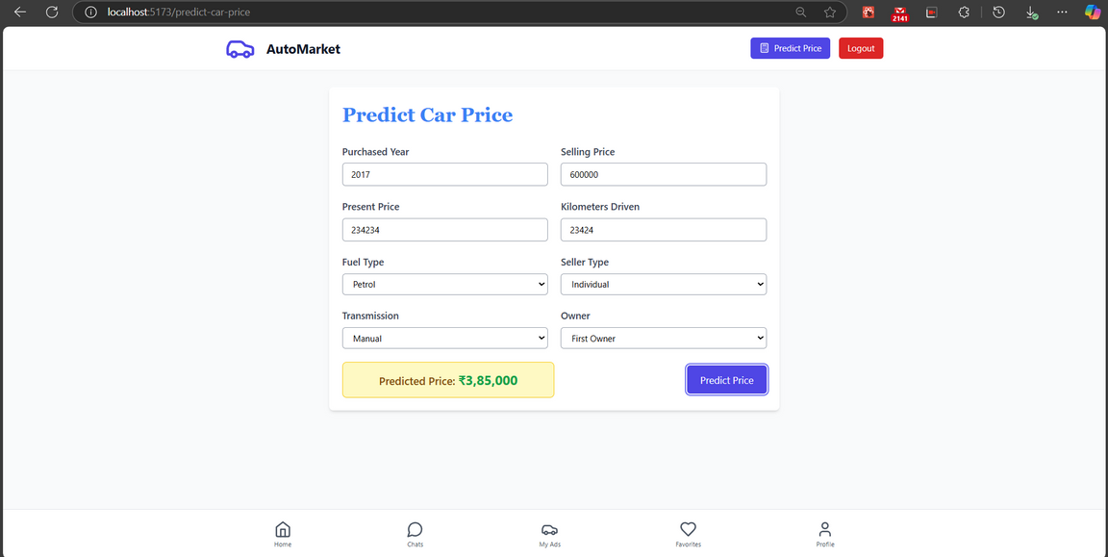
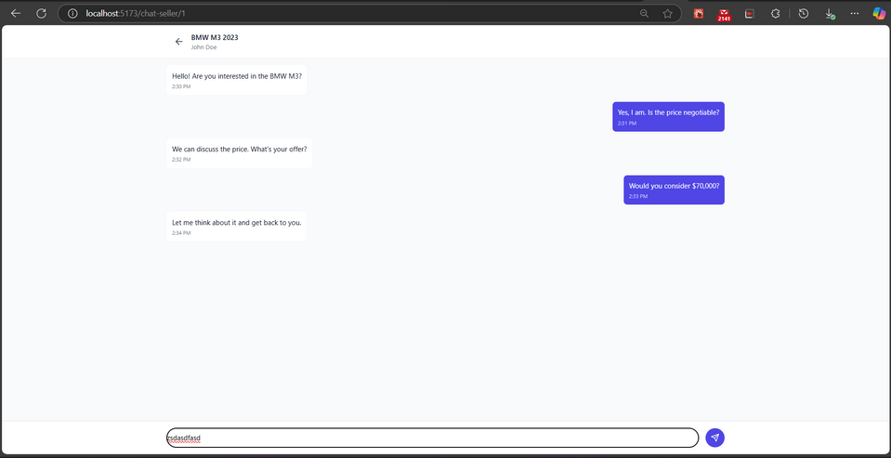
SCREENSHOTS
VEHICLE PRICE PREDICTION PAGE
REAL TIME CHAT

Slide 11
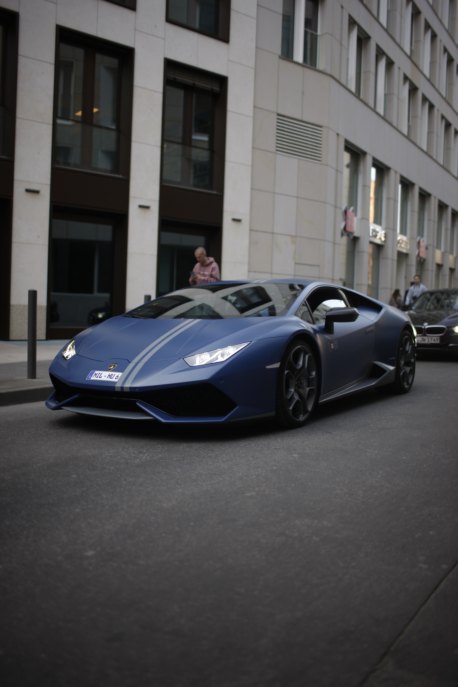
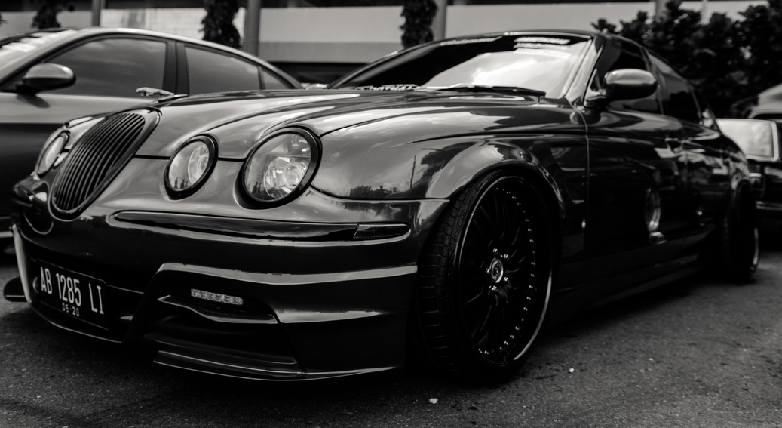
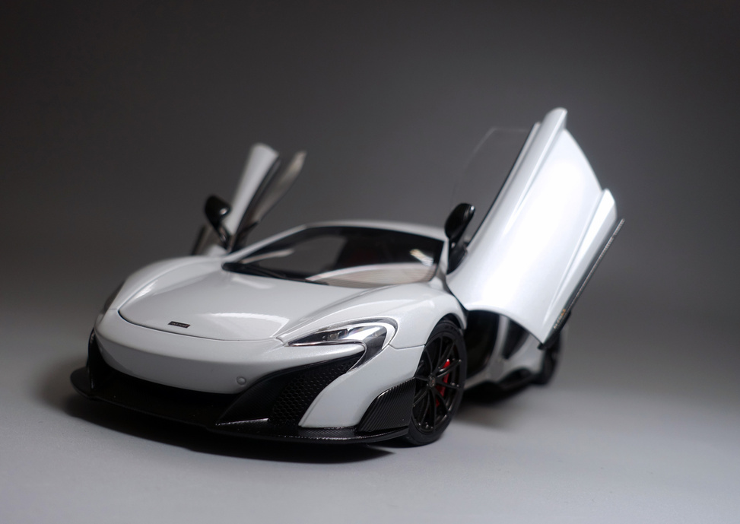
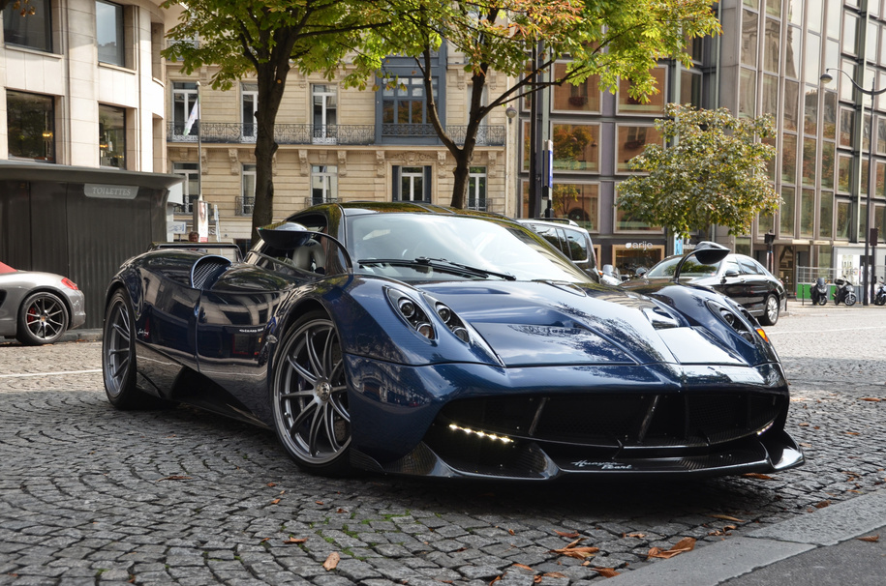
FUTURE SCOPE
MOBILE APP (REACT NATIVE).
BLOCKCHAIN FOR SECURE TRANSACTIONS.
ADVANCED AI: IMAGE-BASED DAMAGE DETECTION.
SUBSCRIPTION MODEL: PREMIUM LISTINGS.

Slide 12
CONCLUSION
AutoMarket solves key pain points in car trading.
Combines tech (AI, real-time chat) + usability.
Potential to scale globally with future upgrades.

Slide 13
REFERENCE LINKS
Similar Apps: Cars24, CarDekho,
Flask Docs: flask.palletsprojects.com
MongoDB Docs: www.mongodb.com/docs
AI Pricing Models: Research papers on vehicle price prediction.

Slide 14
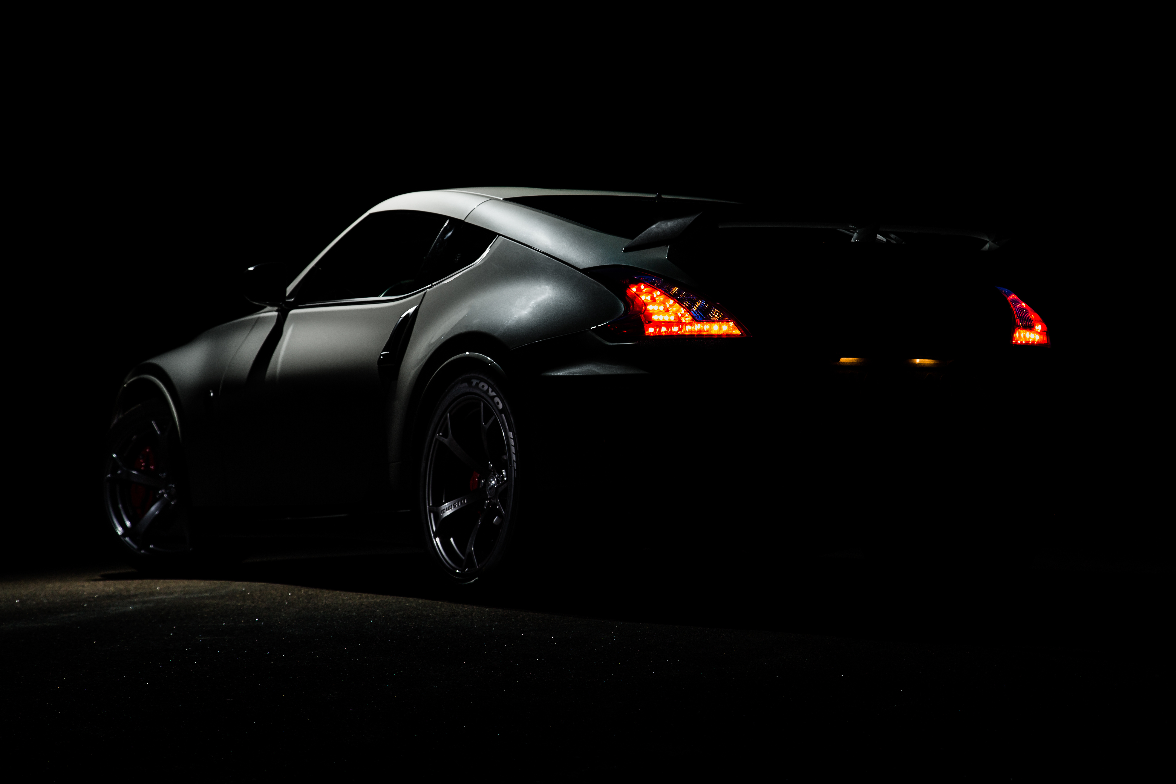


THANK YOU
Prathamesh Palve

